Slide 1

Making the Case for Rust in Embedded Development

Slide 2
What this talk is
Intro to Rust
Some code examples
Not a deep dive

Slide 3
My Background
Primarily C#/.NET Developer
Mostly develop apps in controlled environments
Backend Server
Desktop/Mobile

Slide 4
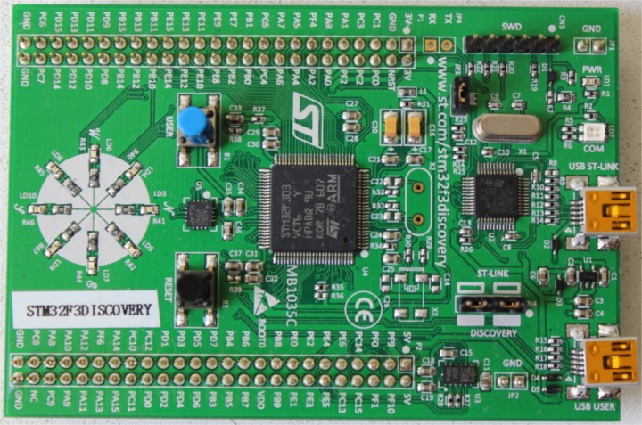
Levels of IoT Devices
Full PC
2 GHz Quad-Core 64-bit CPU
8 GB RAM
Raspberry Pi
1.5 GHz Quad-Core 64-bit CPU
1 to 4 GB RAM
MCU (Arduino)
16 MHz Single-Core 8-bit CPU
2 KB RAM
STM32F303VC
72 MHz Single-Core 32-bit CPU
40 KB SRAM

Slide 5
Let’s talk about C/C++
Built for Speed
Not memory safe
Gotta love them pointers
Building
CMake Script
Have fun setting it up
Unit Testing
Handful of options
Have fun setting it up

Slide 6
1 Year Ago
Cmake
C/C++
Unit Tests with Google Test
It was hard
Never figured out on-board debugging

Slide 7

Code Example!
It’s C Code

Slide 8
What is Rust?
C based syntax
Performance comparable to C++
Created by Mozilla
“Most loved programming language“ in Stack Overflow’s Developer Survey 2016-2019

Slide 9
Why Rust?
New Docs
Memory Safety
Performance

Slide 10
Books!!! and other docs
Basic Rust Book:
https://doc.rust-lang.org/book/
Embedded Rust Book:
https://rust-embedded.github.io/book/intro/index.html

Slide 11
Getting Started
Navigate
Navigate to: https://www.rust-lang.org/
Follow
Follow Instructions to install
Use
Use CLI: `cargo new hello_world`
Navigate
Navigate to hello_world folder
Use
Use CLI: `cargo run hello_world`

Slide 12
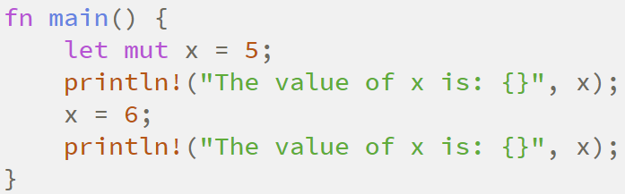
Immutability by Default
Every variable is immutable
Use keyword `mut` to mark is mutable

Slide 13
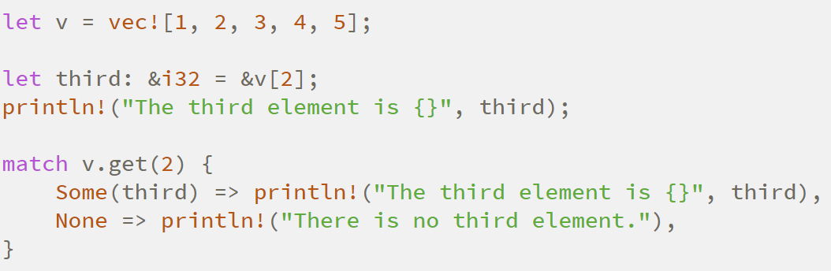
Collections
Standard Collection: Vector
Generic: Vec<i32> creates collection for 32-bit ints
Add items by calling .push()

Slide 14
For C Developers
Use iterators where possible
Every index is bounds checked, so performance is slower
Use references everywhere you can
Pointers are considered unsafe
Instead of using `volatile` keyword use read_volatile() and write_volatile methods

Slide 15
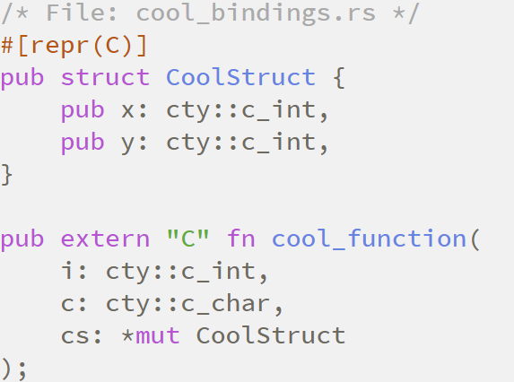
Using C Code
Can reference C code through Rust
Setup the interface manually or use `bindgen` tool to generate

Slide 16
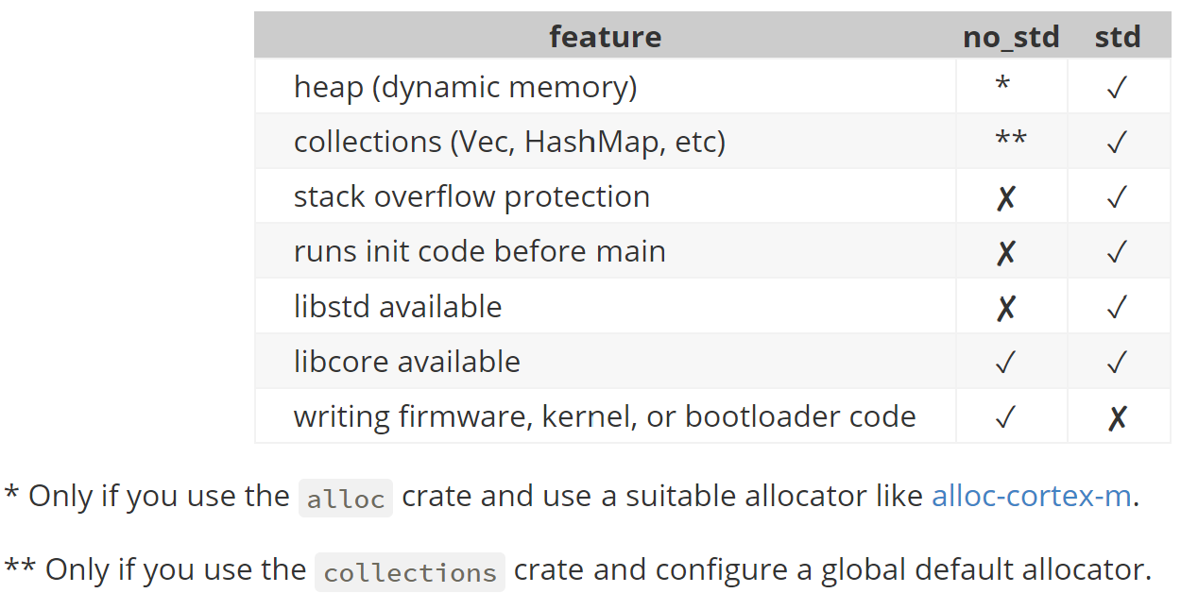
No Embedded “Standard Library”
Embedded devices are small
Alternative: no_std

Slide 17
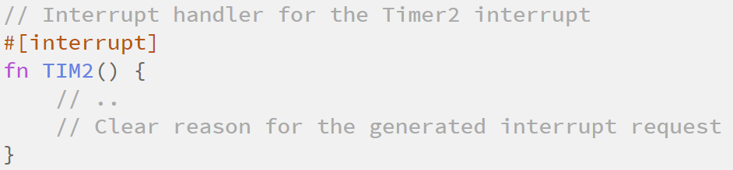
Interrupts and Exceptions
#[interrupt] and #[exception] attributes
Board specific

Slide 18
Cargo
Used for managing app stuff
Build/new/download package/etc

Slide 19
Crates
Built in package manager
See them Online: Crates.io
Creates for embedded dev
For specific board
Peripherals like serial port
Just like a library from the manufacturer in C/C++
Notes:
Atmel Include: C:\Program Files (x86)\Atmel\Studio\7.0\toolchain\avr8\avr8-gnu-toolchain\avr\include

Slide 20
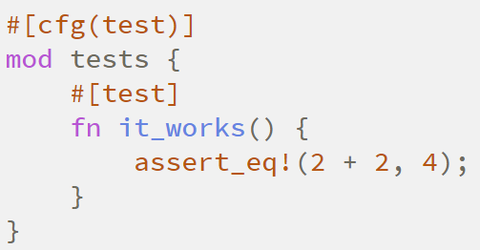
Unit Testing
To Add: Add a new project: cargo new my-tests --lib
To Run: cargo test

